Slide 1
Advanced Stress Packages
Introduction to Groundwater Modeling Using MODFLOW

Slide 2
Advanced Stress Packages
More advanced stresses
Lake (LAK)
Streamflow Routing (SFR)
Multi-Aquifer Well (MAW)
Unsaturated Zone Flow (UZF)
Mover (MVR)
Typically involve solving some form of a water budget equation
As part of the formulation step (LAK, SFR, UZF, MVR)
Added as rows in the system of equations solved (MAW)

Slide 3
Advanced Stress Packages
State variables (e.g. head, stage, water content) are available for all advanced stress packages (except MVR Package)
ASCII – print_head, print_stage
Binary – save_head, save_stage, water_content (hds format)
Budgets are available for all advanced stress packages
Incremental and Cumulative budgets in the listing file
ASCII – print_flows
Binary – save_flows (cell-by-cell format)
Observations
State variables
Flow variables

Slide 4
Lake (LAK) Package

Slide 5
LAK Package Capabilities
Capabilities
multiple outlets per lake using 3 outlet equation options (specified, Manning, weir)
lakes on top of model (overlying), incised lakes, embedded lakes (sub-grid scale lakes)
constant stage and inactive lakes
explicitly defined lake connectivity
currently no UZF under lakes

Slide 6
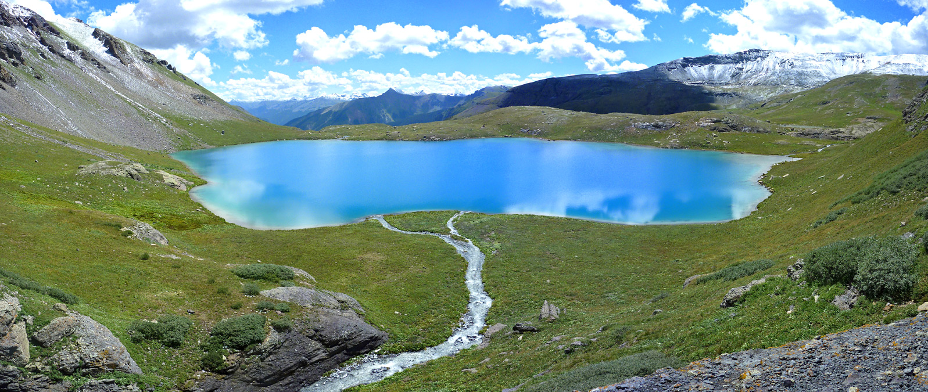
LAK Package Continuity Equation

Slide 7
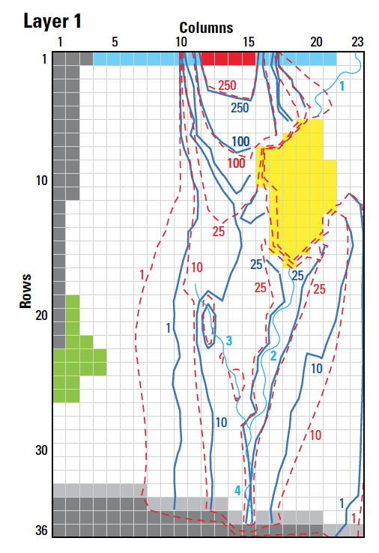
LAK Package Input
BEGIN Options
PRINT_INPUT
PRINT_STAGE
PRINT_FLOWS
SAVE_FLOWS
STAGE FILEOUT mf6-gwt.lak.stage.bin
BUDGET FILEOUT mf6-gwt.lak.cbc
MOVER
DEV_GROUNDWATER_HEAD_CONDUCTANCE
TIME_CONVERSION 86400.000
END Options
BEGIN DIMENSIONS
NLAKES 2
NOUTLETS 1
END DIMENSIONS
BEGIN PACKAGEDATA
# LAKENO STRT NLAKECONN
1 44.000000 78
2 35.200001 32
END PACKAGEDATA
BEGIN CONNECTIONDATA
# LAKENO ICONN CELLID CLAKTYPE BEDLEAK BELEV TELEV CONNLEN CONNWIDTH
1 1 1 5 19 HORIZONTAL 1.000000 0.000000 0.000000 201.8585 405.6650
1 2 1 5 20 HORIZONTAL 1.000000 0.000000 0.000000 201.8585 405.6650
1 3 1 6 18 HORIZONTAL 1.000000 0.000000 0.000000 202.8325 403.7170
1 4 1 6 18 HORIZONTAL 1.000000 0.000000 0.000000 201.8585 405.6650
--- DELETED INPUT ---

Slide 8
LAK Package Input – cont.
--- DELETED INPUT ---
2 22 2 23 2 VERTICAL 1.000000 0.000000 0.000000 0.000000 0.000000
2 23 2 23 3 VERTICAL 1.000000 0.000000 0.000000 0.000000 0.000000
2 24 2 23 4 VERTICAL 1.000000 0.000000 0.000000 0.000000 0.000000
2 25 2 24 1 VERTICAL 1.000000 0.000000 0.000000 0.000000 0.000000
2 26 2 24 2 VERTICAL 1.000000 0.000000 0.000000 0.000000 0.000000
2 27 2 24 3 VERTICAL 1.000000 0.000000 0.000000 0.000000 0.000000
2 28 2 24 4 VERTICAL 1.000000 0.000000 0.000000 0.000000 0.000000
2 29 2 25 1 VERTICAL 1.000000 0.000000 0.000000 0.000000 0.000000
2 30 2 25 2 VERTICAL 1.000000 0.000000 0.000000 0.000000 0.000000
2 31 2 26 1 VERTICAL 1.000000 0.000000 0.000000 0.000000 0.000000
2 32 2 26 2 VERTICAL 1.000000 0.000000 0.000000 0.000000 0.000000
END CONNECTIONDATA
BEGIN OUTLETS
# OUTLETNO LAKEIN LAKEOUT COUTTYPE INVERT WIDTH ROUGH SLOPE
1 1 0 MANNING 44.5 5.000000 0.30000000E-01 0.2187500E-02
END OUTLETS
BEGIN PERIOD 1
1 RAINFALL 0.0000000
1 EVAPORATION 0.0000000
1 RUNOFF 0.0000000
1 WITHDRAWAL 0.0000000
2 RAINFALL 0.0000000
2 EVAPORATION 0.0000000
2 RUNOFF 0.0000000
2 WITHDRAWAL 0.0000000
END PERIOD

Slide 9
LAK Package Output
LAK-1 BUDGET FOR ENTIRE MODEL AT END OF TIME STEP 1, STRESS PERIOD 1
------------------------------------------------------------------------------
CUMULATIVE LAK-1 L**3 RATES FOR THIS TIME STEP L**3/T
------------------ ------------------------
IN: IN:
--- ---
EXT-INFLOW = 0.0000 EXT-INFLOW = 0.0000
FROM-MVR = 873431546.1767 FROM-MVR = 191332.2116
RAINFALL = 0.0000 RAINFALL = 0.0000
RUNOFF = 0.0000 RUNOFF = 0.0000
GWF = 1637700230.5291 GWF = 358751.4196
EVAPORATION = 0.0000 EVAPORATION = 0.0000
WITHDRAWAL = 0.0000 WITHDRAWAL = 0.0000
EXT-OUTFLOW = 0.0000 EXT-OUTFLOW = 0.0000
TO-MVR = 0.0000 TO-MVR = 0.0000
STORAGE = 0.0000 STORAGE = 0.0000
CONSTANT = 0.0000 CONSTANT = 0.0000
TOTAL IN = 2511131776.7058 TOTAL IN = 550083.6313
OUT: OUT:
---- ----
EXT-INFLOW = 0.0000 EXT-INFLOW = 0.0000
FROM-MVR = 0.0000 FROM-MVR = 0.0000
RAINFALL = 0.0000 RAINFALL = 0.0000
RUNOFF = 0.0000 RUNOFF = 0.0000
GWF = 1281783019.2116 GWF = 280784.8892
EVAPORATION = 0.0000 EVAPORATION = 0.0000
WITHDRAWAL = 0.0000 WITHDRAWAL = 0.0000
EXT-OUTFLOW = 284.8235 EXT-OUTFLOW = 6.2393E-02
TO-MVR = 1229229296.0636 TO-MVR = 269272.5731
STORAGE = 0.0000 STORAGE = 0.0000
CONSTANT = 0.0000 CONSTANT = 0.0000
TOTAL OUT = 2511012600.0987 TOTAL OUT = 550057.5247
IN - OUT = 119176.6071 IN - OUT = 26.1066
PERCENT DISCREPANCY = 0.00 PERCENT DISCREPANCY = 0.00

Slide 10
LAK Package Output – cont.
LAKE (LAK-1) STAGE PERIOD 1 STEP 1
------------------
LAKE LAKE
NO. STAGE
------------------
1 45.08
2 37.14
LAKE (LAK-1) FLOWS PERIOD 1 STEP 1
------------------------------------------------------------------------------------------------------------------------------------------------------------------------------------------------------
LAKE LAKE INTERNAL LAKE LAKE LAKE LAKE LAKE LAKE LAKE LAKE EXTERNAL INTERNAL LAKE CONSTANT LAKE PERCENT
NO. INFLOW INFLOW RUNOFF FROM MVR RAINFALL LEAKAGE IN LEAKAGE OUT EVAPORATION WITHDRAWAL STORAGE OUTFLOW OUTFLOW TO MVR FLOW IN - OUT DIFFERENCE
------------------------------------------------------------------------------------------------------------------------------------------------------------------------------------------------------
1 0.000 0.000 0.000 0.1913E+06 0.000 0.2138E+06 -0.1358E+06 -0.000 0.000 0.000 -0.6239E-01 0.000 -0.2693E+06 0.000 0.6135 0.1514E-03
2 0.000 0.000 0.000 0.000 0.000 0.1450E+06 -0.1449E+06 -0.000 0.000 0.000 0.000 0.000 0.000 0.000 25.49 0.1759E-01

Slide 11
StreamFlow Routing (SFR) Package

Slide 12
SFR Package Capabilities
Capabilities
multiple diversions from a single reach
downstream outflow from a reach to multiple segments using user-specified time-varying discharge fractions.
diversion priority scheme can be implemented based on diversion order
Inactive reaches
rectangular reaches
stream data are specified by reach
explicitly defined reach connectivity
currently no UZF under reaches
no Kinematic Routing (no reach storage changes)

Slide 13
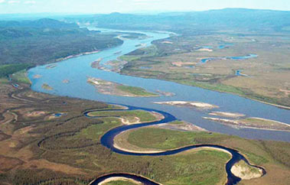
SFR Package Continuity Equation

Slide 14
SFR Package Connectivity

Slide 15
SFR Package Input
BEGIN OPTIONS
PRINT_STAGE
PRINT_FLOWS
UNIT_CONVERSION 128390.00
MOVER
SAVE_FLOWS
STAGE FILEOUT mf6-gwt.sfr.stage.bin
BUDGET FILEOUT mf6-gwt.sfr.cbc
END OPTIONS
BEGIN DIMENSIONS
NREACHES 38
END DIMENSIONS
BEGIN PACKAGEDATA
#RNO CELLID RLEN RWID RGRD RBTP RBTH RBHK MAN NCON USTRF NDV
1 1 1 23 400.0000 5.000000 0.1818182E-02 48.63636 1.000000 100.0000 0.3000000E-01 1 1.0000 0
2 1 2 23 200.0000 5.000000 0.1818182E-02 48.09091 1.000000 100.0000 0.3000000E-01 2 1.0000 0
3 1 2 22 400.0000 5.000000 0.1818182E-02 47.54546 1.000000 100.0000 0.3000000E-01 2 1.0000 0
4 1 3 21 400.0000 5.000000 0.1818182E-02 46.81818 1.000000 100.0000 0.3000000E-01 2 1.0000 0
5 1 4 20 400.0000 5.000000 0.1818182E-02 46.09091 1.000000 100.0000 0.3000000E-01 2 1.0000 0
6 1 5 20 400.0000 5.000000 0.1818182E-02 45.36364 1.000000 100.0000 0.3000000E-01 1 1.0000 0
7 1 17 18 400.0000 5.000000 0.2187500E-02 44.06250 1.000000 100.0000 0.3000000E-01 1 1.0000 0
8 1 18 18 400.0000 5.000000 0.2187500E-02 43.18750 1.000000 100.0000 0.3000000E-01 2 1.0000 0
9 1 19 18 400.0000 5.000000 0.2187500E-02 42.31250 1.000000 100.0000 0.3000000E-01 2 1.0000 0
--- DELETED INPUT ---

Slide 16
SFR Package Input – cont.
--- DELETED INPUT ---
34 1 31 15 400.0000 5.000000 0.2428571E-02 31.57143 1.000000 100.0000 0.3000000E-01 2 1.0000 0
35 1 32 15 400.0000 5.000000 0.2428571E-02 30.60000 1.000000 100.0000 0.3000000E-01 2 1.0000 0
36 1 33 15 400.0000 5.000000 0.2428571E-02 29.62857 1.000000 100.0000 0.3000000E-01 2 1.0000 0
37 1 34 15 400.0000 5.000000 0.2428571E-02 28.65714 1.000000 100.0000 0.3000000E-01 2 1.0000 0
38 1 35 15 400.0000 5.000000 0.2428571E-02 27.68571 1.000000 100.0000 0.3000000E-01 1 1.0000 0
END PACKAGEDATA
BEGIN CONNECTIONDATA
1 -2
2 1 -3
3 2 -4
4 3 -5
5 4 -6
6 5
7 -8
8 7 -9
9 8 -10
10 9 -11
11 10 -12
12 11 -13
13 12 -14
14 13 -15
15 14 -16
16 15 -17
17 16 -18
--- DELETED INPUT ---

Slide 17
SFR Package Input – cont.
--- DELETED INPUT ---
18 17 -32
19 -20
20 19 -21
21 20 -22
22 21 -23
23 22 -24
24 23 -25
25 24 -26
26 25 -27
27 26 -28
28 27 -29
29 28 -30
30 29 -31
31 30 -32
32 18 31 -33
33 32 -34
34 33 -35
35 34 -36
36 35 -37
37 36 -38
38 37
END CONNECTIONDATA
BEGIN PERIOD 1
1 INFLOW 86400.000
END PERIOD
BEGIN PERIOD 2
1 INFLOW 95040.
END PERIOD

Slide 18
SFR Package Output
SFR-1 BUDGET FOR ENTIRE MODEL AT END OF TIME STEP 1, STRESS PERIOD 1
------------------------------------------------------------------------------
CUMULATIVE SFR-1 L**3 RATES FOR THIS TIME STEP L**3/T
------------------ ------------------------
IN: IN:
--- ---
EXT-INFLOW = 394416000.0000 EXT-INFLOW = 86400.0000
FROM-MVR = 1229229296.0636 FROM-MVR = 269272.5731
RAINFALL = 0.0000 RAINFALL = 0.0000
RUNOFF = 0.0000 RUNOFF = 0.0000
GWF = 1083367995.0924 GWF = 237320.4809
EVAPORATION = 0.0000 EVAPORATION = 0.0000
EXT-OUTFLOW = 0.0000 EXT-OUTFLOW = 0.0000
TO-MVR = 0.0000 TO-MVR = 0.0000
TOTAL IN = 2707013291.1560 TOTAL IN = 592993.0539
OUT: OUT:
---- ----
EXT-INFLOW = 0.0000 EXT-INFLOW = 0.0000
FROM-MVR = 0.0000 FROM-MVR = 0.0000
RAINFALL = 0.0000 RAINFALL = 0.0000
RUNOFF = 0.0000 RUNOFF = 0.0000
GWF = 973384747.4528 GWF = 213227.7650
EVAPORATION = 0.0000 EVAPORATION = 0.0000
EXT-OUTFLOW = 860196997.5266 EXT-OUTFLOW = 188433.0772
TO-MVR = 873431546.1767 TO-MVR = 191332.2116
TOTAL OUT = 2707013291.1560 TOTAL OUT = 592993.0539
IN - OUT = 0.0000 IN - OUT = 0.0000
PERCENT DISCREPANCY = 0.00 PERCENT DISCREPANCY = 0.00

Slide 19
SFR Package Output – cont.
SFR (SFR-1) STAGE PERIOD 1 STEP 1
------------------------------------------------------------------------------------------------
REACH REACH REACH REACH REACH GWF STREAMBED STREAMBED
NO. (LAYER,ROW,COLUMN) STAGE DEPTH WIDTH HEAD CONDUCTANCE GRADIENT
------------------------------------------------------------------------------------------------
1 (1,1,23) 48.87 0.2330 5.000 48.81 0.2000E+06 0.5916E-01
2 (1,2,23) 48.31 0.2158 5.000 48.23 0.1000E+06 0.7507E-01
3 (1,2,22) 47.79 0.2398 5.000 47.96 0.2000E+06 -0.1737
4 (1,3,21) 47.11 0.2953 5.000 47.29 0.2000E+06 -0.1767
5 (1,4,20) 46.43 0.3415 5.000 46.58 0.2000E+06 -0.1506
6 (1,5,20) 45.74 0.3767 5.000 45.86 0.2000E+06 -0.1203
--- DELETED OUTPUT ---
33 (1,30,15) 32.93 0.3870 5.000 32.91 0.2000E+06 0.2451E-01
34 (1,31,15) 31.95 0.3823 5.000 31.93 0.2000E+06 0.1949E-01
35 (1,32,15) 30.98 0.3778 5.000 30.96 0.2000E+06 0.2165E-01
36 (1,33,15) 30.00 0.3724 5.000 29.97 0.2000E+06 0.2780E-01
37 (1,34,15) 29.02 0.3657 5.000 28.99 0.2000E+06 0.3262E-01
38 (1,35,15) 28.04 0.3590 5.000 28.02 0.2000E+06 0.2771E-01
SFR (SFR-1) FLOWS PERIOD 1 STEP 1
----------------------------------------------------------------------------------------------------------------------------------------------------------------------------
REACH REACH EXTERNAL REACH REACH REACH REACH REACH REACH REACH EXTERNAL REACH REACH PERCENT
NO. (LAYER,ROW,COLUMN) INFLOW INFLOW FROM MVR RAINFALL RUNOFF LEAKAGE EVAPORATION OUTFLOW OUTFLOW TO MVR IN - OUT DIFFERENCE
----------------------------------------------------------------------------------------------------------------------------------------------------------------------------
1 (1,1,23) 0.8640E+05 0.000 0.000 0.000 0.000 -0.1183E+05 0.000 -0.7457E+05 0.000 0.000 0.000 0.000
2 (1,2,23) 0.000 0.7457E+05 0.000 0.000 0.000 -7507. 0.000 -0.6706E+05 0.000 0.000 0.000 0.000
3 (1,2,22) 0.000 0.6706E+05 0.000 0.000 0.000 0.3475E+05 0.000 -0.1018E+06 0.000 0.000 0.000 0.000
4 (1,3,21) 0.000 0.1018E+06 0.000 0.000 0.000 0.3534E+05 0.000 -0.1371E+06 0.000 0.000 0.000 0.000
5 (1,4,20) 0.000 0.1371E+06 0.000 0.000 0.000 0.3013E+05 0.000 -0.1673E+06 0.000 0.000 0.000 0.000
6 (1,5,20) 0.000 0.1673E+06 0.000 0.000 0.000 0.2406E+05 0.000 0.000 -0.8168E-02 -0.1913E+06 0.000 0.000
--- DELETED OUTPUT ---
33 (1,30,15) 0.000 0.2192E+06 0.000 0.000 0.000 -4901. 0.000 -0.2143E+06 0.000 0.000 0.000 0.000
34 (1,31,15) 0.000 0.2143E+06 0.000 0.000 0.000 -3898. 0.000 -0.2104E+06 0.000 0.000 0.000 0.000
35 (1,32,15) 0.000 0.2104E+06 0.000 0.000 0.000 -4329. 0.000 -0.2061E+06 0.000 0.000 0.000 0.000
36 (1,33,15) 0.000 0.2061E+06 0.000 0.000 0.000 -5561. 0.000 -0.2005E+06 0.000 0.000 0.000 0.000
37 (1,34,15) 0.000 0.2005E+06 0.000 0.000 0.000 -6525. 0.000 -0.1940E+06 0.000 0.000 0.000 0.000
38 (1,35,15) 0.000 0.1940E+06 0.000 0.000 0.000 -5541. 0.000 0.000 -0.1884E+06 0.000 0.000 0.000

Slide 20
Multi-Aquifer Well (MAW) Package

Slide 21
MAW Package Capabilities
Capabilities
Solved as part of the matrix solution
Simplified data input
Flexible connectivity
Several well conductance formulations
Constraints (flow reduction and well shutdown)
Flowing well option
Can account for interbore storage changes
Constant and inactive wells
Differences
No support for
horizontal wells
partial penetration
non-linear head losses

Slide 22
MAW Package Input
BEGIN OPTIONS
PRINT_INPUT
PRINT_FLOWS
BOUNDNAMES
AUXILIARY AUX1 AUX2
TS6 FILEIN maw_rates.ts
OBS6 FILEIN NT_Transient.maw.obs
NO_WELL_STORAGE
end options
BEGIN DIMENSIONS
NMAWWELLS 1
END DIMENSIONS
BEGIN PACKAGEDATA
# NO RADIUS BOTTOM STRT CONDEQN NGWNODES AUX1 AUX2 NAME
1 0.15 -514.9 9.14 SPECIFIED 2 100 1.0 NTWELL
END PACKAGEDATA
BEGIN CONNECTIONDATA
# CONN L R C STOP SBOT K RSKIN
1 1 1 51 51 -50 -514.9 111.53 0
1 2 2 51 51 -50 -514.9 446.62 0
END CONNECTIONDATA
BEGIN PERIOD 1
1 RATE MAWQ1
END PERIOD

Slide 23
MAW Package Output
MAW-NT_WELL BUDGET FOR ENTIRE MODEL AT END OF TIME STEP 50, STRESS PERIOD 3
------------------------------------------------------------------------------
CUMULATIVE MAW-NT_WELL L**3 RATES FOR THIS TIME STEP L**3/T
------------------ ------------------------
IN: IN:
--- ---
GWF = 32931.1497 GWF = 2767.0000
RATE = 0.0000 RATE = 0.0000
CONSTANT = 0.0000 CONSTANT = 0.0000
TOTAL IN = 32931.1497 TOTAL IN = 2767.0000
OUT: OUT:
---- ----
GWF = 1170.8715 GWF = 0.0000
RATE = 31760.2781 RATE = 2767.0000
CONSTANT = 0.0000 CONSTANT = 0.0000
TOTAL OUT = 32931.1497 TOTAL OUT = 2767.0000
IN - OUT = 3.8031E-07 IN - OUT = 4.3552E-08
PERCENT DISCREPANCY = 0.00 PERCENT DISCREPANCY = 0.00

Slide 24
MAW Package Output – cont.
MULTI-AQUIFER WELL (MAW-NT_WELL) HEAD PERIOD 3 STEP 50
----------------------------------
WELL WELL WELL
NAME NO. HEAD
----------------------------------
NTWELL 1 0.2729
MULTI-AQUIFER WELL (MAW-NT_WELL) FLOWS PERIOD 3 STEP 50
------------------------------------------------------------------------------------------
WELL WELL GWF GWF WELL CONSTANT WELL PERCENT
NAME NO. IN OUT RATE FLOW IN - OUT DIFFERENCE
------------------------------------------------------------------------------------------
NTWELL 1 2767. 0.000 -2767. 0.000 0.4355E-07 0.1574E-08

Slide 25
Unsaturated Zone Flow (UZF) Package

Slide 26
UZF Package Continuity Equation
Kinematic-wave Equation for vertical unsaturated flow provides a solution for gravity flow with internal drainage.
Water Content
Internal drainage
Wetting
Front
Water
Table

Slide 27
UZF Package Variables
Brooks-Corey Equation
Required input variables

Slide 28
UZF Package Capabilities
Intended for basin scale studies
Simulates
Gravity flow in the unsaturated zone
Evapotranspiration (unsaturated and saturated)
Infiltration excess (rejected infiltration)
Saturation excess (groundwater discharge to land surface)

Slide 29
UZF Package
Head/Elevation
Head/Elevation
Recharge
Recharge
Problem!
Smooth
0.0
0.0
Discharge
Discharge
Land surface
Land surface
No micro topography
With micro topography
Micro Topography Solves Infiltration/Discharge Discontinuity Problem

Slide 30
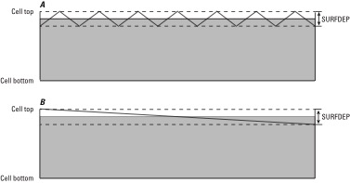
UZF Package Infiltration

Slide 31
UZF Package Groundwater Seepage
Groundwater Seepage – Water Table is Close to Land Surface

Slide 32
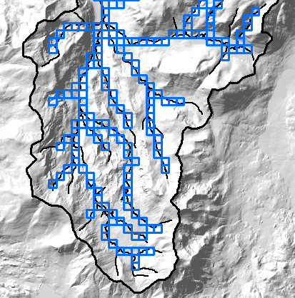
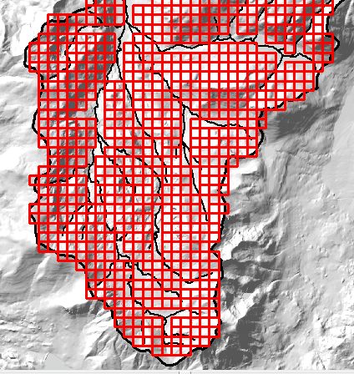
UZF Package – multiple packages
UZF package 1
UZF package 2
Stream seepage
Mountain slope

Slide 33
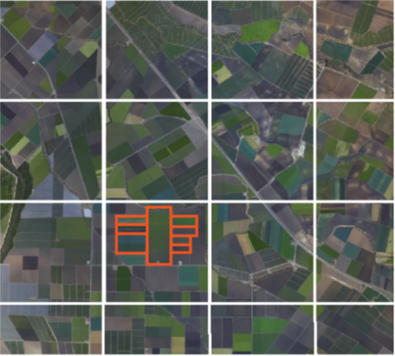
UZF Package – sub-grid features
Coarse GWF grid
UZF cells correspond to GWF grid in areas with less data
UZF cells corresponding to different land use types

Slide 34
UZF Package Input
BEGIN OPTIONS
BOUNDNAMES
PRINT_INPUT
PRINT_FLOWS
SAVE_FLOWS
SIMULATE_ET
LINEAR_GWET
SIMULATE_GWSEEP
MOVER
OBS6 FILEIN uzfp3_lakmvr_v2_uzf.obs
BUDGET FILEOUT uzf.cbc
END OPTIONS
BEGIN DIMENSIONS
NUZFCELLS 200
NTRAILWAVES 10
NWAVESETS 50
END DIMENSIONS
BEGIN PACKAGEDATA
# NO CELLID LFLG VCON SURFDEP VKS THTR THTS THTI EPS BOUNDANAME
1 1 1 1 1 101 0.1 1.00E-06 0.1 0.3 0.11 3.5 uzfcells
2 1 1 2 1 102 0.1 1.00E-06 0.1 0.3 0.11 3.5 uzfcells
3 1 2 1 1 103 0.1 1.00E-06 0.2 0.3 0.21 3.5 uzfcells
--- DELETED INPUT ---

Slide 35
UZF Package Input – cont.
--- DELETED INPUT ---
198 2 15 4 0 0 0.1 1.00E-06 0.2 0.3 0.21 3.5 uzfcells
199 2 15 5 0 0 0.1 1.00E-06 0.2 0.3 0.21 3.5 uzfcells
200 2 15 6 0 0 0.1 1.00E-06 0.2 0.3 0.21 3.5 uzfcells
END PACKAGEDATA
BEGIN PERIOD 1
# uzfid finf pet extdp extwc ha hroot rootact
1 3.34E-10 1.00E-08 15 0.100005 0.0 0.0 0.0
2 6.68E-10 1.00E-08 15 0.100005 0.0 0.0 0.0
3 6.68E-10 1.00E-08 15 0.20001 0.0 0.0 0.0
--- DELETED INPUT ---
98 2.68E-09 1.00E-08 15 0.20001 0.0 0.0 0.0
99 2.68E-09 1.00E-08 15 0.20001 0.0 0.0 0.0
100 2.68E-09 1.00E-08 15 0.20001 0.0 0.0 0.0
END PERIOD

Slide 36
UZF Package Output
UZF_1 BUDGET FOR ENTIRE MODEL AT END OF TIME STEP 15, STRESS PERIOD 24
------------------------------------------------------------------------------
CUMULATIVE UZF_1 L**3 RATES FOR THIS TIME STEP L**3/T
------------------ ------------------------
IN: IN:
--- ---
INFILTRATION = 6044703271.2000 INFILTRATION = 7.6500
FROM-MVR = 0.0000 FROM-MVR = 0.0000
REJ-INF = 0.0000 REJ-INF = 0.0000
REJ-INF-TO-MVR = 0.0000 REJ-INF-TO-MVR = 0.0000
GWF = 0.0000 GWF = 0.0000
UZET = 0.0000 UZET = 0.0000
STORAGE = 3703929635.3310 STORAGE = 63.3814
TOTAL IN = 9748632906.5310 TOTAL IN = 71.0314
OUT: OUT:
---- ----
INFILTRATION = 0.0000 INFILTRATION = 0.0000
FROM-MVR = 0.0000 FROM-MVR = 0.0000
REJ-INF = 1640.8837 REJ-INF = 0.0000
REJ-INF-TO-MVR = 24978080.1659 REJ-INF-TO-MVR = 5.0001E-02
GWF = 2902536811.0348 GWF = 45.0327
UZET = 1336852282.2118 UZET = 22.7992
STORAGE = 5484263955.0108 STORAGE = 3.1496
TOTAL OUT = 9748632769.3070 TOTAL OUT = 71.0314
IN - OUT = 137.2240 IN - OUT = 1.7748E-06
PERCENT DISCREPANCY = 0.00 PERCENT DISCREPANCY = 0.00

Slide 37
UZF Package Output – cont.
UZF (UZF_1) FLOWS PERIOD 24 STEP 15
-----------------------------------------------------------------------------------------------------------------------------------------------------------
UZF UZF UZF UZF-UZF UZF UZF UZF REJ-INF UZF UZF UZF-UZF UZF UZF PERCENT
NAME NO. INFILT. INFLOW FROM MVR REJ-INF TO MVR UZET GWRCH OUTFLOW STORAGE IN - OUT DIFFERENCE
-----------------------------------------------------------------------------------------------------------------------------------------------------------
UZFCELLS 1 0.2500E-01 0.000 0.000 0.000 0.000 -0.2109 0.000 -0.6988E-03 0.1866 -0.2211E-10 -0.1045E-07
UZFCELLS 2 0.5000E-01 0.000 0.000 0.000 0.000 -0.2500 0.000 -0.6988E-03 0.2007 -0.3919E-13 -0.1563E-10
UZFCELLS 3 0.5000E-01 0.000 0.000 0.000 0.000 -0.2500 0.000 -0.9262 1.126 0.1825E-12 0.1552E-10
UZFCELLS 4 0.2500E-01 0.000 0.000 0.000 0.000 -0.2109 0.000 -0.6988E-03 0.1866 -0.2211E-10 -0.1045E-07
UZFCELLS 5 0.5000E-01 0.000 0.000 0.000 0.000 -0.2500 0.000 -0.6988E-03 0.2007 -0.3919E-13 -0.1563E-10
UZFCELLS 6 0.2000 0.000 0.000 0.000 0.000 -0.2500 0.000 -0.8730 0.9230 -0.5684E-13 -0.5062E-11
UZFCELLS 7 0.2000 0.000 0.000 0.000 0.000 -0.2500 0.000 -0.8730 0.9230 -0.5684E-13 -0.5062E-11
UZFCELLS 8 0.1250 0.000 0.000 0.000 0.000 -0.2500 0.000 -0.8888 1.014 -0.1732E-13 -0.1521E-11
UZFCELLS 9 0.1250 0.000 0.000 0.000 0.000 -0.2500 0.000 -0.8888 1.014 -0.1732E-13 -0.1521E-11
UZFCELLS 10 0.2500E-01 0.000 0.000 0.000 0.000 -0.2109 0.000 -0.6988E-03 0.1866 -0.2211E-10 -0.1045E-07
UZFCELLS 11 0.2500E-01 0.000 0.000 0.000 0.000 -0.2109 0.000 -0.6988E-03 0.1866 -0.2211E-10 -0.1045E-07
UZFCELLS 12 0.2000 0.000 0.000 0.000 0.000 -0.2500 0.000 -0.8730 0.9230 -0.5684E-13 -0.5062E-11
UZFCELLS 13 0.2000 0.000 0.000 0.000 0.000 -0.2500 0.000 -0.8730 0.9230 -0.5684E-13 -0.5062E-11
UZFCELLS 14 0.1250 0.000 0.000 0.000 0.000 -0.2500 -0.8094 0.000 0.9344 -0.2731E-13 -0.2578E-11
--- DELETED OUTPUT ---
UZFCELLS 187 0.000 0.000 0.000 0.000 0.000 0.000 0.000 0.000 -0.000 0.000 0.000
UZFCELLS 188 0.000 0.000 0.000 0.000 0.000 0.000 0.000 0.000 -0.000 0.000 0.000
UZFCELLS 189 0.000 0.000 0.000 0.000 0.000 0.000 0.000 0.000 -0.000 0.000 0.000
UZFCELLS 190 0.000 0.000 0.000 0.000 0.000 0.000 0.000 0.000 -0.000 0.000 0.000
UZFCELLS 191 0.000 0.000 0.000 0.000 0.000 0.000 0.000 0.000 -0.000 0.000 0.000
UZFCELLS 192 0.000 0.000 0.000 0.000 0.000 0.000 0.000 0.000 -0.000 0.000 0.000
UZFCELLS 193 0.000 0.000 0.000 0.000 0.000 0.000 0.000 0.000 -0.000 0.000 0.000
UZFCELLS 194 0.000 0.000 0.000 0.000 0.000 0.000 0.000 0.000 -0.000 0.000 0.000
UZFCELLS 195 0.000 0.000 0.000 0.000 0.000 0.000 0.000 0.000 -0.000 0.000 0.000
UZFCELLS 196 0.000 0.000 0.000 0.000 0.000 0.000 0.000 0.000 -0.000 0.000 0.000
UZFCELLS 197 0.000 0.8730 0.000 0.000 0.000 0.000 -0.7460 0.000 -0.1270 0.7972E-07 0.9132E-05
UZFCELLS 198 0.000 0.8730 0.000 0.000 0.000 0.000 -0.7484 0.000 -0.1246 0.7972E-07 0.9132E-05
UZFCELLS 199 0.000 0.8730 0.000 0.000 0.000 0.000 -0.7562 0.000 -0.1169 0.7972E-07 0.9132E-05
UZFCELLS 200 0.000 0.8730 0.000 0.000 0.000 0.000 -0.7650 0.000 -0.1080 0.7972E-07 0.9132E-05

Slide 38
Mover (MVR) Package

Slide 39
MVR Package
CONSTRAINTS
PROVIDER
RECEIVER
Package
Discharge
One to One
Provider 1
Receiver 1
One to Many
Receiver 2
Provider 2
Receiver 3
Many to One
Provider 3
Receiver 4
Provider 4

Slide 40
MVR Package Providers and Receivers
Provider
Drain package
General-head boundary package
River package
Well package
Provider and Receiver
Lake package
Multi-aquifer well package
Streamflow routing package
Unsaturated zone package
Available water for mover is reduced by multiple receivers with the same provider in order listed in Mover package

Slide 41
MVR Package Constraints
Fraction
Discharge x fraction is sent to the receiver
Excess
Any water that exceeds the user-specified rate is provided to the receiver. No water is provided to the receiver if the available water is less than the user-specified value. (Flood control)

Slide 42
MVR Package Constraints
Threshold
No flow is provided to the receiver until the available water exceeds the user-specified rate. Once the available water exceeds the user-specified rate, then the user-specified rate is provided to the receiver. (Priority)
Up To
All of the available water will be taken from the provider up to the user-specified rate. Once user-specified rate is exceeded, the receiver will continue to get the user-specified rate.

Slide 43
MVR Package Input
BEGIN OPTIONS
PRINT_INPUT
PRINT_FLOWS
BUDGET FILEOUT mvr.cbc
END OPTIONS
BEGIN DIMENSIONS
MAXMVR 3
MAXPACKAGES 2
END DIMENSIONS
BEGIN PACKAGES
SFR-1
LAK-1
END PACKAGES
BEGIN PERIOD 1
SFR-1 6 LAK-1 1 FACTOR 1.000000000000000
LAK-1 1 SFR-1 7 FACTOR 1.000000000000000
END PERIOD

Slide 44
MVR Package Input – cont.
BEGIN OPTIONS
PRINT_INPUT
PRINT_FLOWS
BUDGET FILEOUT mvr.cbc
END OPTIONS
BEGIN DIMENSIONS
MAXMVR 104
MAXPACKAGES 3
END DIMENSIONS
BEGIN PACKAGES
SFR_1
LAK_1
UZF_1
END PACKAGES
BEGIN PERIOD 1
SFR_1 23 LAK_1 1 FACTOR 1.000000000000000
LAK_1 1 SFR_1 24 FACTOR 1.000000000000000
--- DELETED INPUT ---
UZF_1 99 LAK_1 2 FACTOR 1.000000000000000
UZF_1 100 LAK_1 2 FACTOR 1.000000000000000
END PERIOD

Slide 45
MVR Package Output
WATER MOVER BUDGET FOR ENTIRE MODEL AT END OF TIME STEP 1, STRESS PERIOD 1
------------------------------------------------------------------------------
CUMULATIVE WATER MOVER L**3 RATES FOR THIS TIME STEP L**3/T
------------------ ------------------------
IN: IN:
--- ---
SFR-1 = 873431546.1767 SFR-1 = 191332.2116
LAK-1 = 1229229296.0636 LAK-1 = 269272.5731
TOTAL IN = 2102660842.2403 TOTAL IN = 460604.7847
OUT: OUT:
---- ----
SFR-1 = 1229229296.0636 SFR-1 = 269272.5731
LAK-1 = 873431546.1767 LAK-1 = 191332.2116
TOTAL OUT = 2102660842.2403 TOTAL OUT = 460604.7847
IN - OUT = 0.0000 IN - OUT = 0.0000
PERCENT DISCREPANCY = 0.00 PERCENT DISCREPANCY = 0.00

